Slide 1
Automatic Topic Tagging for documents using an API INTERNSHIP
G C GANESH
19R11A1213
IT-3A

Slide 2
CONTENTS
Introduction
Analysis
System requirements specifications
Technology
Tools
Uses
Conclusion

Slide 3
Introdution
SmartBridge:
Project Tittle:Automatic Topic Tagging for documents using an API
Period of Internship:

Slide 4
Analysis
Businesses deal with large volumes of unstructured text every day. Think about all of the customer interacfions and brand menfions in emails, support fickets, social media posts, online feedback and reviews, and other informafion that an organizafion sends and receives. The list is endless. When it comes to analyzing huge amounts of text data, it’s just too big a task to do manually. It’s also tedious, fime-consuming, and expensive. Manually sorfing through large amounts of data is more likely to lead to mistakes and inconsistencies.
Topic analysis is a Natural Language Processing (NLP) technique that allows us to
automafically extract meaning from texts by idenfifying recurrent themes or topics. Topic analysis models enable you to sih through large sets of data and idenfify the most common and most important topics in an easy, fast, and completely scalable way.
In this guided lab we will be building a web applicafion using ﬂask which accepts text data
from the user and gets the top topic tags using Topic Tagging API.

Slide 5
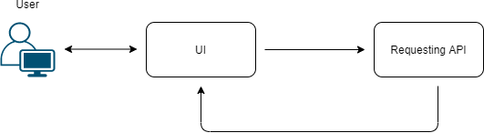
Architecture:
What is an API?
API is the acronym for Application Programming Interface, which is a software
intermediary that allows two applications to talk to each other. Each time you use anapp like Facebook, send an instant message, or check the weather on your phone, you're using an API.

Slide 6
How to build a basic ﬂask app?
Flask is a small and lightweight Python web framework that provides useful tools and features that make creating web applications in Python easier. It gives developers ﬂexibility and is a more accessible framework for new developers since you can build a web application quickly using only a single Python ﬁle. Flask is also extensible and
doesn’t force a particular directory structure or require complicated boilerplate code before getting started.
What is Topic Tagging?
Topic tags allow users to filter between forums and display topics with a specific topic tag. If topic tagging is enabled, when a user creates a topic they have the ability to add specific tags to quickly explain what a post is about and it also helps users find
related topics based on those tags.

Slide 7
System requirements specifications
SystemConfiguratiom :Intel i3 7th Gen processor,8GbB RAM
Software Requirements : Windows os,
Tools :
anaconda navigator,visual code python
Hardware Requirements :none

Slide 8
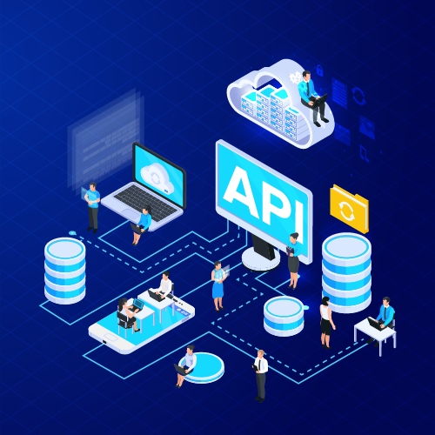
APl Technology

Slide 9
What is an API?
Application programming interface (API) is a connection between computers or between computer programs. It is a type of software interface, offering a service to other pieces of software.^{[1]} A document or standard that describes how to build or use such a connection or interface is called an API specification. A computer system that meets this standard is said to implement or expose an API. The term API may refer either to the specification or to the implementation.
In contrast to a user interface, which connects a computer to a person, an application programming interface connects computers or pieces of software to each other. It is not intended to be used directly by a person (the end user) other than a computer programmer who is incorporating it into software. An API is often made up of different parts which act as tools or services that are available to the programmer. A program or a programmer that uses one of these parts is said to call that portion of the API. The calls that make up the API are also known as subroutines, methods, requests, or endpoints. An API specification defines these calls, meaning that it explains how to use or implement them.

Slide 10
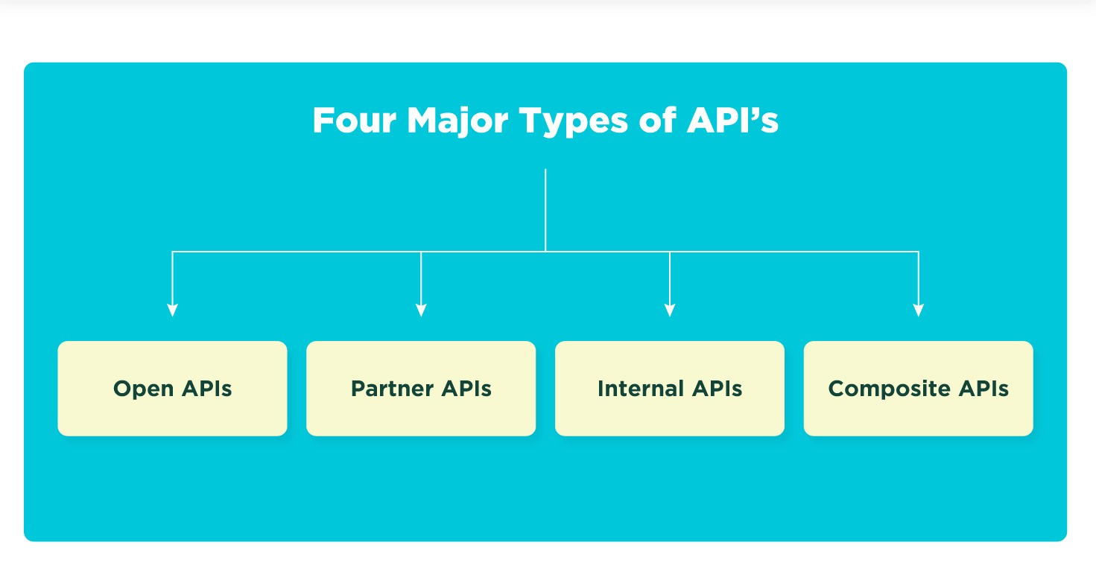
Types of API

Slide 11
API
Open APIs
Open APIs, also known as external or public APIs, are available to developers and other users with minimal restrictions. They may require registration, and use of an API key, or may be completely open. They are intended for external users (developers at other companies, for example) to access data or services.
Partner APIs
Partner APIs are technically similar to open APIs, but they feature restricted access, often controlled through a third-party API gateway. They are usually intended for a specific purpose, such as providing access to a paid-for service. This is a very common pattern in software as a service ecosystem.
Internal APIs
In contrast to open APIs, internal APIs are designed to be hidden from external users. They are used within a company to share resources. They allow different teams or sections of a business to consume each other’s tools, data and programs
Composite APIs
Composite APIs allow developers to access several endpoints in one call. These could be different endpoints of a single API, or they could be multiple services or data sources. Composite APIs are especially useful in microservice architectures, where a user may need information from several services to perform a single task

Slide 12
Uses of AUTO TAGGING
Saves you the work of manually tagging every final URL.
Eliminates the errors you can introduce when you attempt to manually tag each URL. ...
Allows you to import Analytics goals and transactions into Ads Conversion Tracking.
Offers more detailed Analytics reporting

Slide 13
CONCLUSION
Tags are important to transmit information to external applications about visits to the web page on which the tags are embedded. For example, one of the simpler things a JavaScript tag can do is detect and transmit the date or the version of the viewer’s browser. The capabilities of tags to detect, transmit or invoke browser plug-ins go well beyond these simple examples. For the most part, tags exist on web pages and perform their designated functions outside the awareness of the page visitor.

Slide 14
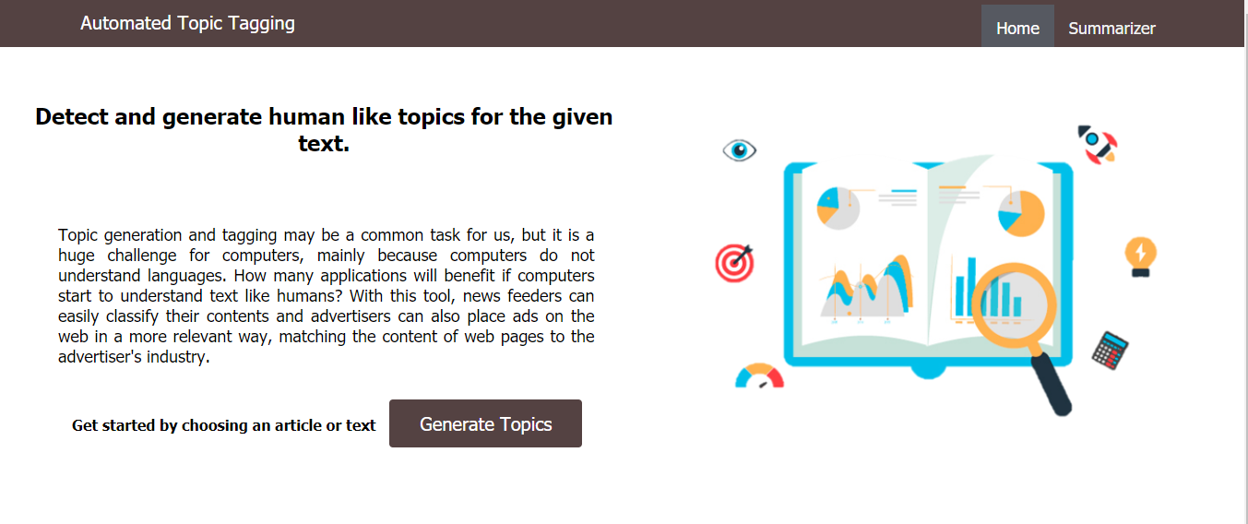

Slide 15
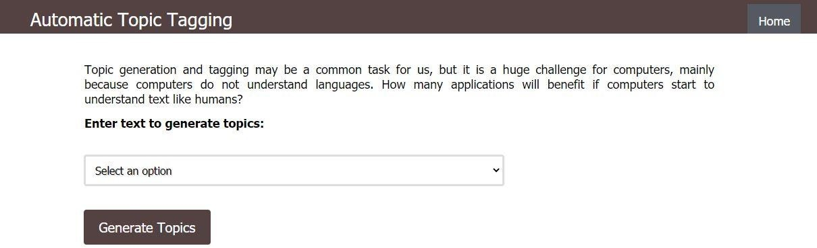

Slide 16
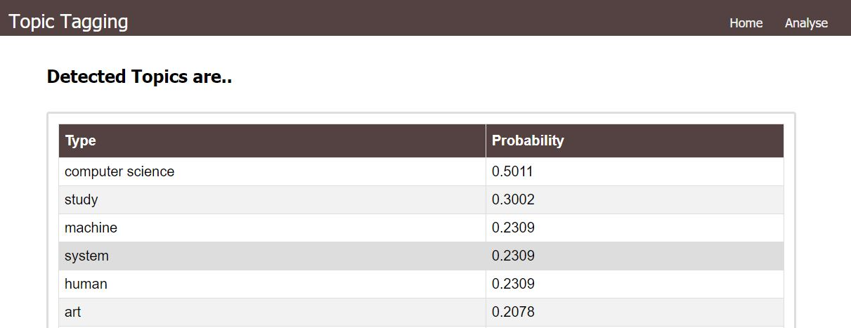

Slide 17
THANK YOU
Gcganesh
19R11A1213

